Slide 1

2026 Annual General Meeting
The Annual General Meeting of the Adelaide Soaring Club
Saturday 12th September 2026 in the ASC clubrooms, commencing at 5:00pm.
Our Mission
To enjoy safe flying, friendship, and sharing our passion for aviation

Slide 2
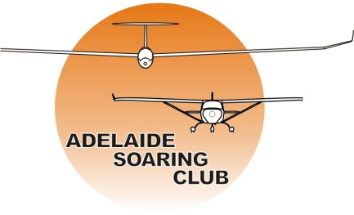
Agenda
Apologies
Minutes of previous AGM – 30th August 2025
Business arising
Reports
  President’s Report
  Treasurer’s Report covering the Auditor’s Report
Notices of Motions
Committee Changes, nominations and election
Close

Slide 3
Apologies

Slide 4
Minutes of Previous Meeting
AGM 30th August 2025

Slide 5
Business Arising

Slide 6
President’s Report
To enjoy safe flying, friendship, and sharing our passion for aviation

Slide 7
Treasurer’s Report

Slide 8
Notice of Motions
No motions have been notified.

Slide 9
Election of Committee
Each year two elected Committee members must step down:
Brian Rau and Tony Lewis have served six consecutive years and therefore must stand down and are not eligible for re-election.
Marcin Nowina-Krowicki resigned from Committee in May.
Mark Ferraretto served on Committee filling a casual vacancy.
There are four vacancies (Brian, Tony, Marcin and Mark) and two nominees, therefore a ballot is not required.
Two nominations for election to Committee:
Peter Smith
  Alan Dean
Peter and Alan are elected to serve on Committee.
That leaves two casual vacancy positions on Committee which the new Committee may resolve to fill.

Slide 10
Questions and Close

